Slide 1
WEEK 5 PROGRESS REPORT

Slide 2
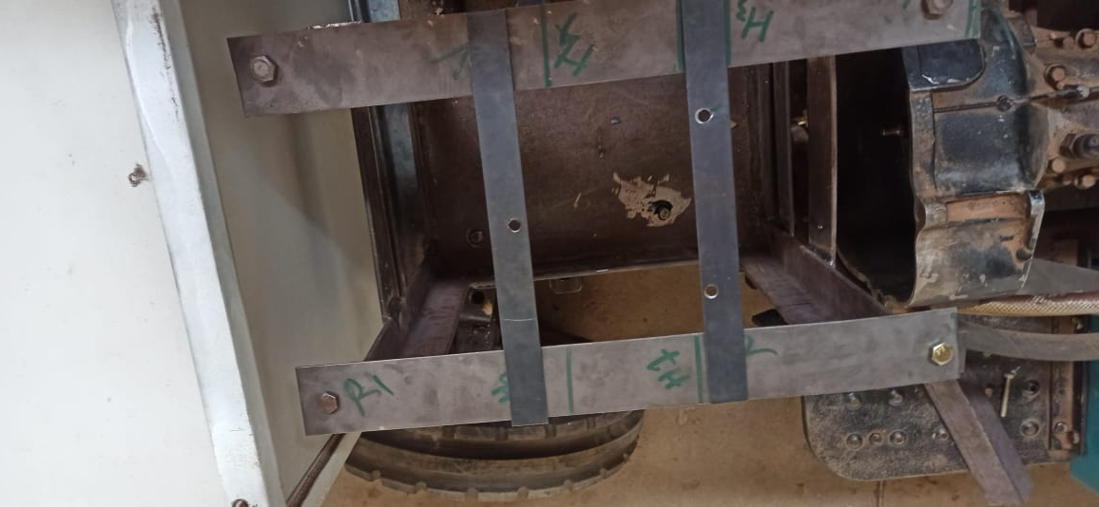
FABRICATION OF FAN MOUNT
The fan mount fabrication and installation was completed

Slide 3
Tasks this week
Design the automated steering mechanism with navigation team
Hydraulic pump mount and coupling

Slide 4
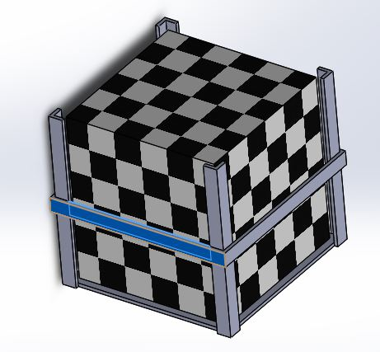
BATTERY MOUNT DESIGN
The design was completed as shown below

Slide 5
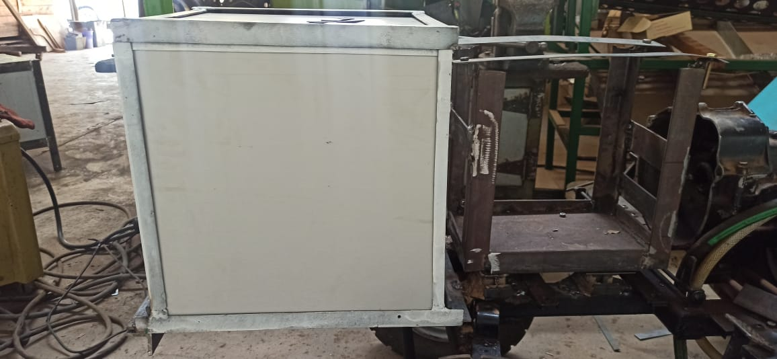
BATTERY MOUNT FABRICATION AND INSTALLATION
The battery was installed with its casing for safety purposes and to minimise on material usage as shown

Slide 6
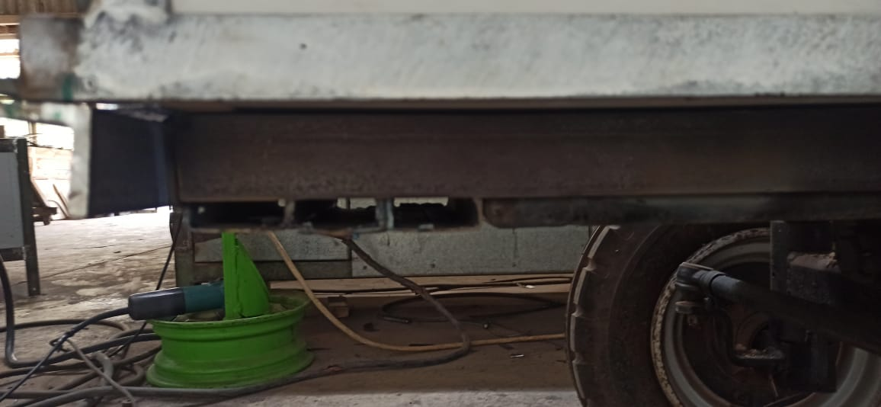
EXTENSION OF THE CHASIS
The chassis was extended using a boxshaft to prevent the battery from overhanging.

Slide 7
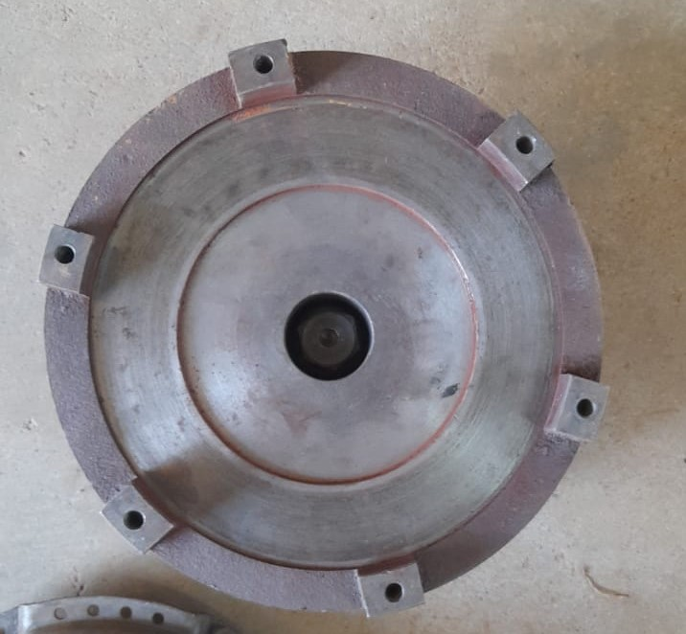
ACQUISITION OF THE FLY WHEEL
The flywheel was unmounted from one of the Shujaa tractors in the BEED workshop as shown

Slide 8
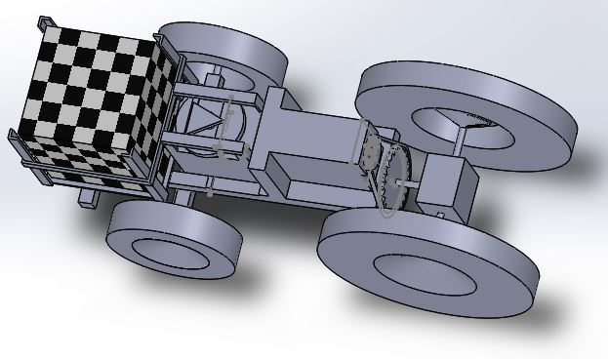
3D CAD REPRESENTATION

